Slide 1
CSE- 271 Software Engineering
Lecture -11

Slide 2
Verification vs validation
Verification:
"Are we building the product right”.
The software should conform to its specification.
Validation:
"Are we building the right product”.
The software should do what the user really requires.

Slide 3
The V & V process
Is a whole life-cycle process - V & V must be applied at each stage in the software process.
Has two principal objectives
  The discovery of defects in a system;
  The assessment of whether or not the system is useful and useable in an operational situation.

Slide 4
V& V goals
Verification and validation should establish confidence that the software is fit for purpose.
This does NOT mean completely free of defects.
Rather, it must be good enough for its intended use and the type of use will determine the degree of confidence that is needed.

Slide 5
Static and dynamic verification
Software inspections:
  Concerned with analysis of the static system representation to discover problems (static verification). They can reveal a variety of information about the structure of the model, modeling techniques used, data and control flows within the model.
    Do not require execution so can be done before implementation too. They may be applied to any representation of the system. Example is Code Analysis, Interface Analysis etc.
    Tools for e.g. static analysers
Software testing:
  Concerned with exercising and observing product behaviour (dynamic verification)
    The system is executed with test data and its operational behaviour is observed.

Slide 6
Testing and debugging
Verification and validation is concerned with establishing the existence of defects in a program.
Debugging is concerned with locating and
repairing these errors.
Debugging involves formulating a hypothesis
about program behaviour then testing these
hypotheses to find the system error.

Slide 7
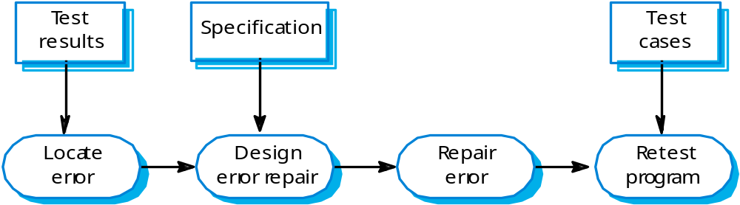
The debugging process

Slide 8
V & V planning
Careful planning is required to get the most out of testing and inspection processes.
Planning should start early in the development process.
The plan should identify the balance between static verification and testing.
Test planning is about defining standards for the testing process rather than describing product tests.

Slide 9
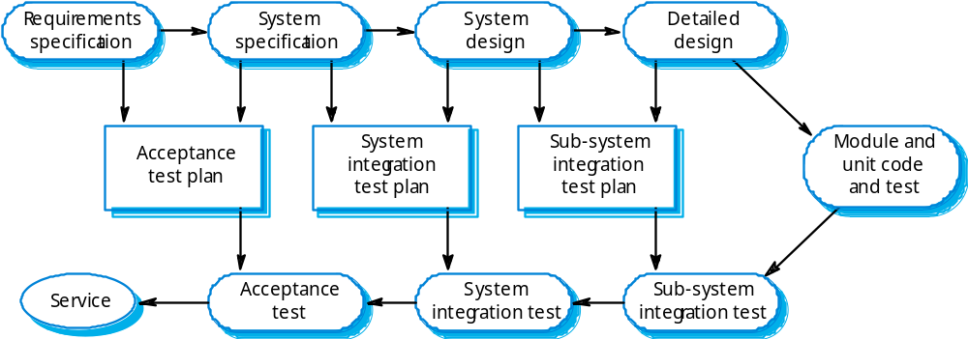
The V-model of development

Slide 10
Software Testing
Testing is the process of exercising a program with the
specific intent of finding errors prior to delivery
to the end user.
OBJECTIVE:
to uncover errors
CRITERIA:
in a complete manner
CONSTRAINT:
with a minimum of effort and time

Slide 11


Who Tests the Software?
developer
independent tester
Understands the system
Must learn about the system,
but, will test "gently"
but, will attempt to break it
and, is driven by "delivery"
and, is driven by quality

Slide 12
Testing policies
Only exhaustive testing can show a program is free from defects. However, exhaustive testing is impossible,
Testing policies define the approach to be used in selecting system tests:
  All functions accessed through menus should be tested;
  Combinations of functions accessed through the same menu should be tested;
  Where user input is required, all functions must be tested with correct and incorrect input.

Slide 13
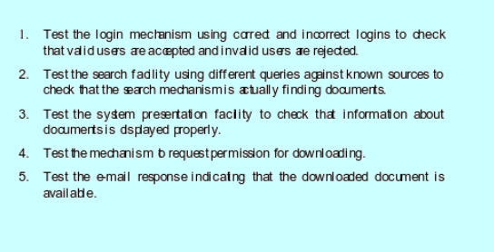
System Tests- Example

Slide 14
Software Testing Techniques
White-box Testing
  Executing and checking all statements in the code.
Black-box Testing
  Testing the system as a black box, giving only inputs and seeing outputs. It is kind of testing that ignores the internal mechanism of a system or component and focuses solely on the outputs generated in response to selected inputs.

Slide 15

White box Testing
... our goal is to ensure that all
statements and conditions have
been executed at least once ...

Slide 16
Black Box Testing
requirements
output
input
events

Slide 17
Levels of Testing
Unit testing
Integration testing
Validation testing
  Focus is on software requirements
System testing
  Focus is on system integration and testing system as a whole
Alpha/Beta or Release testing
  Focus is on customer usage
Stress testing
  executes a system in a manner that demands resources in abnormal quantity, frequency, or volume
Performance Testing
  test the run-time performance of software within the context of an integrated system.

Slide 18



Unit Testing
module
to be
tested
results
software
engineer
interface
local data structures
boundary conditions
independent paths
error handling paths
test cases

Slide 19
Integration testing
Once all the individual units have been tested there is a need to test how they were put together to ensure no data is lost across interface, one module does not have an adverse impact on another and a function is not performed correctly.
Involves building a system from its components and testing it for problems that arise from component interactions.
To simplify error localisation, systems should be incrementally integrated.

Slide 20
System Testing
Involves integrating components to create a system or sub-system.
May involve testing an increment to be delivered to the customer.
Two phases:
  Integration testing - the test team have access to the system source code. The system is tested as components are integrated.
  Release testing - the test team test the complete system to be delivered as a black-box.

Slide 21
Release testing
The process of testing a release of a system that will be distributed to customers.
Primary goal is to increase the supplier’s confidence that the system meets its requirements.
Release testing is usually black-box or functional testing
  Based on the system specification only;
  Testers do not have knowledge of the system implementation.

Slide 22
What is a “Good” Test?
a high probability of finding an error
not redundant.
neither too simple nor too complex

Slide 23
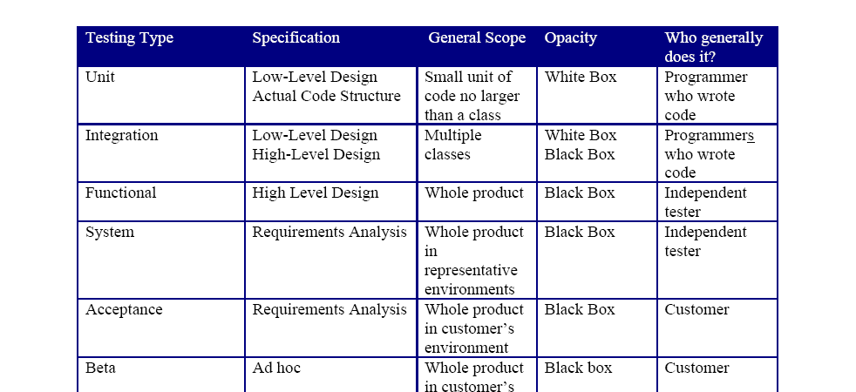
Levels of Software Testing

